Slide 1
Capstone Project.
Crime in Chicago.

Slide 2
Introduction
Crime in Chicago has been a vital issue in the city. The Chicago Police Department's Records office has been tracking them since the early 1900s. It is appreciated how the general crime rate in the city of Chicago is higher than that of the US average. The reasons why Chicago has higher numbers within the US remain unclear.

Slide 3
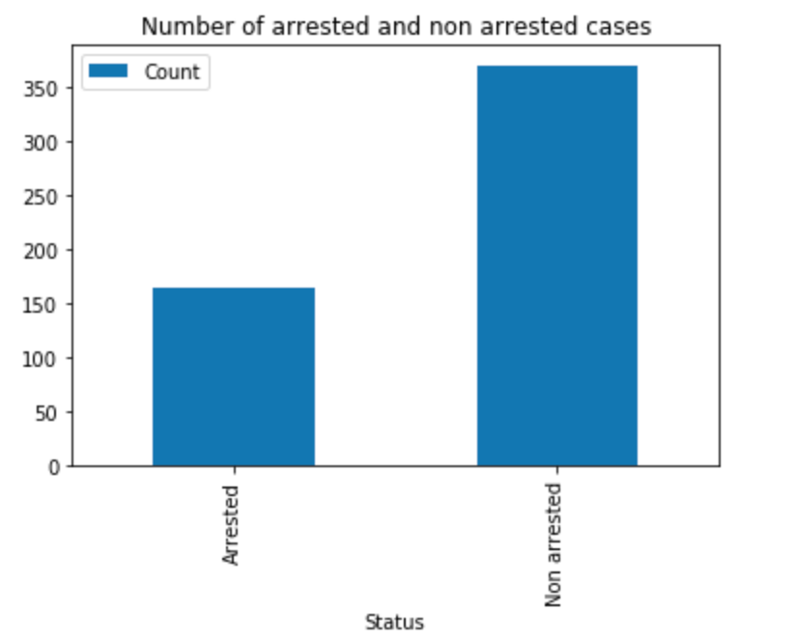
In the following image, we can see the Arrested vs Non Arrested cases.

Slide 4
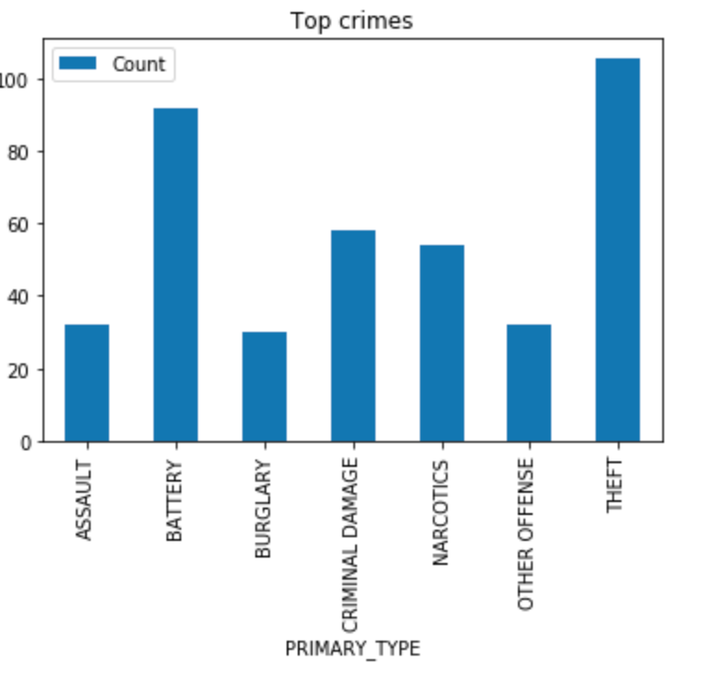
The more repetitive crimes are theft, criminal damage, battery and narcotics.

Slide 5
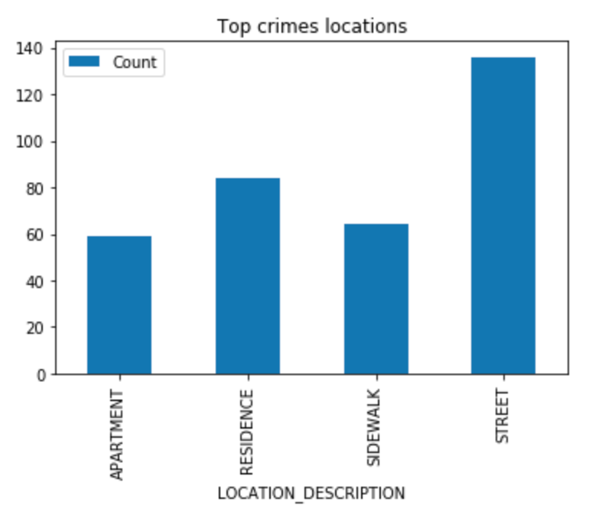
Also, most of the crimes happened on the street.

Slide 6
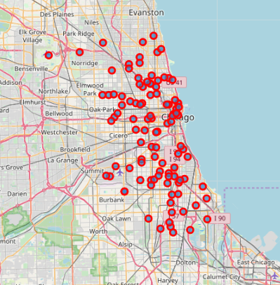
As the image shows, theft crime doesn’t follow a patter, it is randomly situated in the center of city street, then it might be nice to increase police patrol.

Slide 7
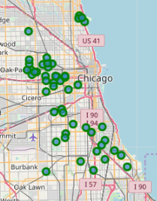
For narcotic crime cases, it mays follow a pattern in oak park and cicero zones for most cases, and such a few others in the south of main zone with some outliers. Maybe it could be good to install police controls in that area.

Slide 8
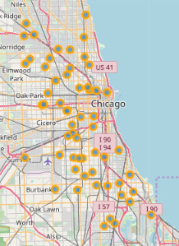
As the map shows, criminal damage crime is a crime highly randomly distributed as theft.

Slide 9
Conclusion
Throughout this presentation, it was demonstrated that the relevant crimes would be robbery and narcotics, among others. Each one has its best way of being prevented, but it is clear that acting on the affected areas and increasing the police presence in the city would be a good start as tools.

